Slide 1

Energy Consumption and Relationship with GDP
By
Pushyami Keerthi
Notes:
To change the image on this slide, select the picture and delete it. Then click the Pictures icon in the placeholder to insert your own image.

Slide 2
Data & Methodology
The purpose of this paper is to analyze the relationship between electricity consumption and annual growth of GSDP at Current prices (Rs. in Crore) in India.
Data
Summarized numbers by Region and Country
Energy Consumption
GSDP(Current)
Time Stamp
Consumption from 2014 to 2017
GSDP (Current) by from 2011 to 2017
Methodology
Correlation
Causation (Linear Regression)
Assumptions: For missing data in GSDP(current), the data is imputed with same growth rate as of previous year.
The data of state-wise is summarized region wise

Slide 3
Components of GDP
1. Private Consumption Expenditure (C)
2. Investment Expenditure (I)
(a) Business Fixed Investment
(b) Inventory Investment (or change in stock)
(c) Residential Construction Investment
(d) Public Investment
3. Government Purchases of Goods and Services (G)
4. Net Exports (X – M)
GDP = C + I + G + (X-M)

Slide 4
Factors affecting GDP and Energy Consumption
GDP
Energy Consumption
Forestry
Trade
Real Estate
Financing
Insurance
Real estate
Business Services
Public Administration
Defense and Other related Services
Population
Region/Location
Age of infrastructure
Agriculture Manufacturing Electricity Supply Water supply Mining-Quarrying Transportation Fishing
Hotels

Slide 5
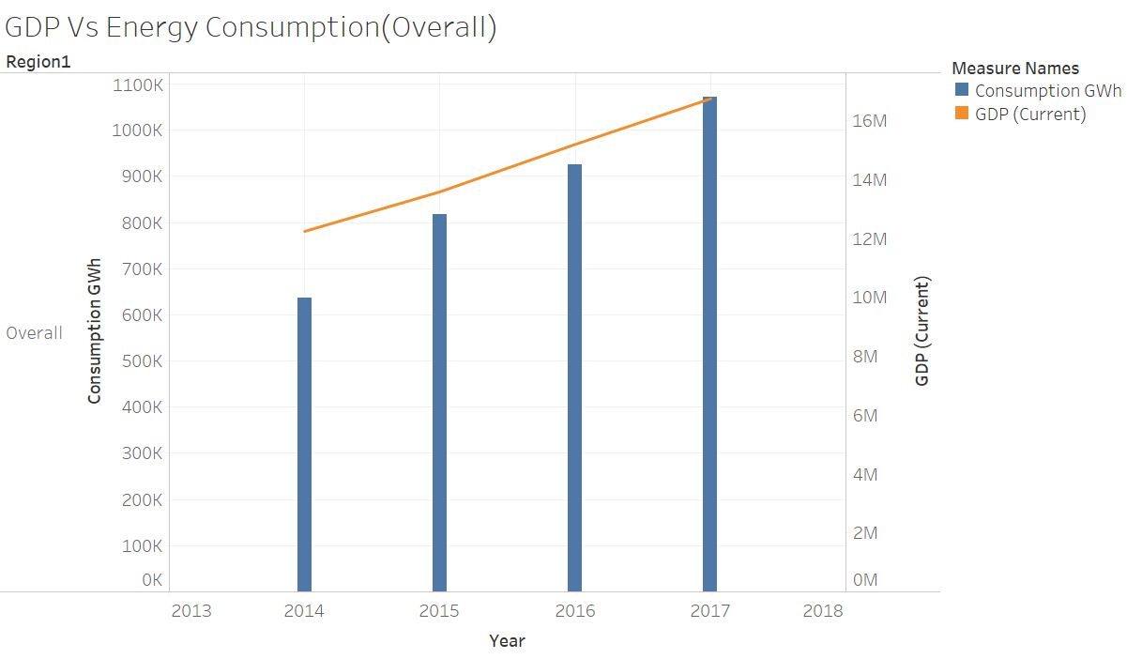
Trend - Consumption and GDP (Overall)
Both Consumption and GDP shows an increasing trend from 2014 to 2017.
The GDP growth rate from 2014 to 2017 is stable and is around 10% per year and the Growth rate of Consumption is not linear.

Slide 6
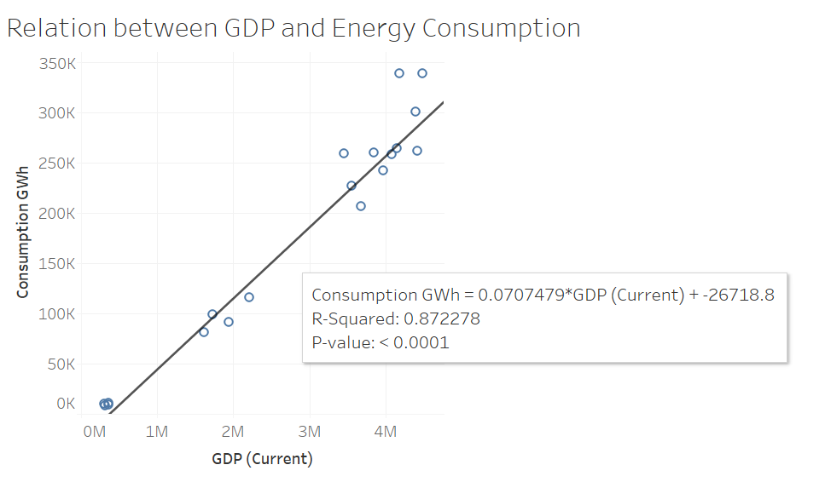
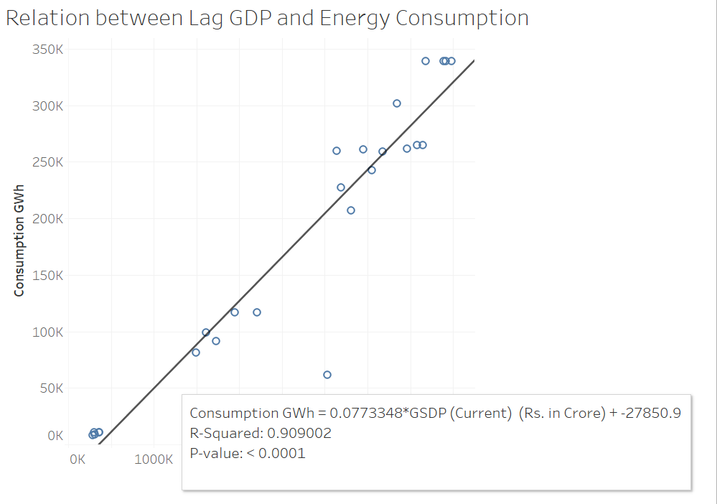
GDP and Energy Consumption(Overall)- Linear Regression
Dependent Variable: Consumption(2014-2017) Vs Independent Variables : GDP and Lag GDP (2013-2017)
Used linear Regression to predict the Consumption given GDP and Lag GDP. Observed high R-Squared value (> 85%) in both models. This shows the strong causation of GDP and Lag GDP to predict consumption.
GDP and Consumption are measured in the same time period and are interdependable. GDP as a model variable includes the impact of the performing period. Hence, GDP is not considered as model variable.
Model with Lagged GDP is not captured any future information which overlaps the Dependent variable consumption. So can be used as the final model variable when compared to GDP.

Slide 7
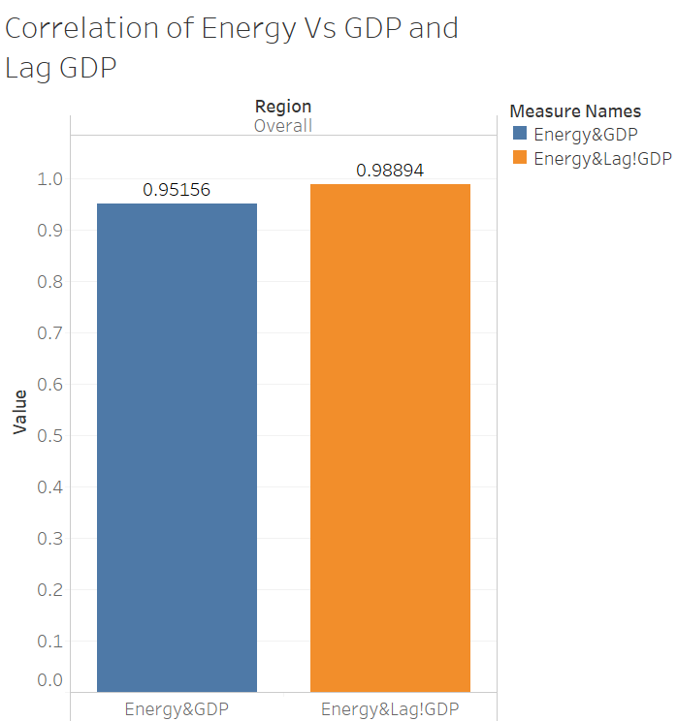
GDP and Energy Consumption (Overall) - Correlation & Regression Coefficients
The Consumption trend is similar to GDP from 2014 to 2017 and is evident by high correlation (>85%) between Consumption and GDP / Lag GDP.
Overall | GDP | Intercept | R-Square | P-Value | Correlation
GDP (2014-2017) | 0.0925 | -26718.9 | 95% | 1% | 0.9516
Lag GDP (2013-2016) | 0.0993 | -27850.9 | 98% | 0% | 0.9890
Overall, the country is having positive correlation between the energy consumption and GDP .
With the high GDP/Lag GDP coefficient it is quite evident that GDP is causing the energy consumption drive to increase over period of time.
Higher R-square and low P-value of Lag GDP confirms the assumption of Lag GDP as the model variable instead of GDP.
However, this assumes the each region has similar trend and relationship. Further region level analysis was performed to verify this assumption.

Slide 8
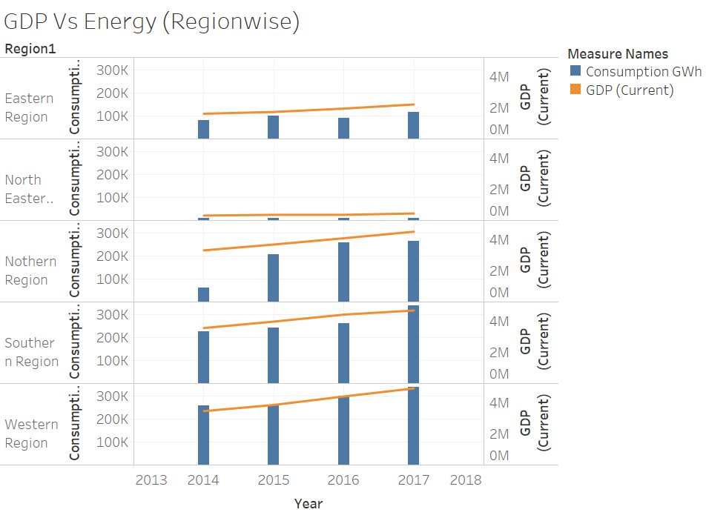
Trend - Consumption and GDP (By Region)
GDP shows an increasing trend from 2014 to 2017 in all Regions.
Consumption shows an increasing trend from 2014 to 2017 except for the Regions East and North-East.
The GDP growth rate from 2014 to 2017 is not similar across the regions but still follows an increasing trend.
GDP and Consumption are measured in the same time period and are interdependable. GDP as a model variable includes the impact of the performing period. Hence, GDP is not considered as model variable.
Lagged GDP is considered as the final model variable as it is not captured any future information which overlaps the Dependent variable consumption.
Used linear Regression to predict the Consumption given Lagged GDP

Slide 9
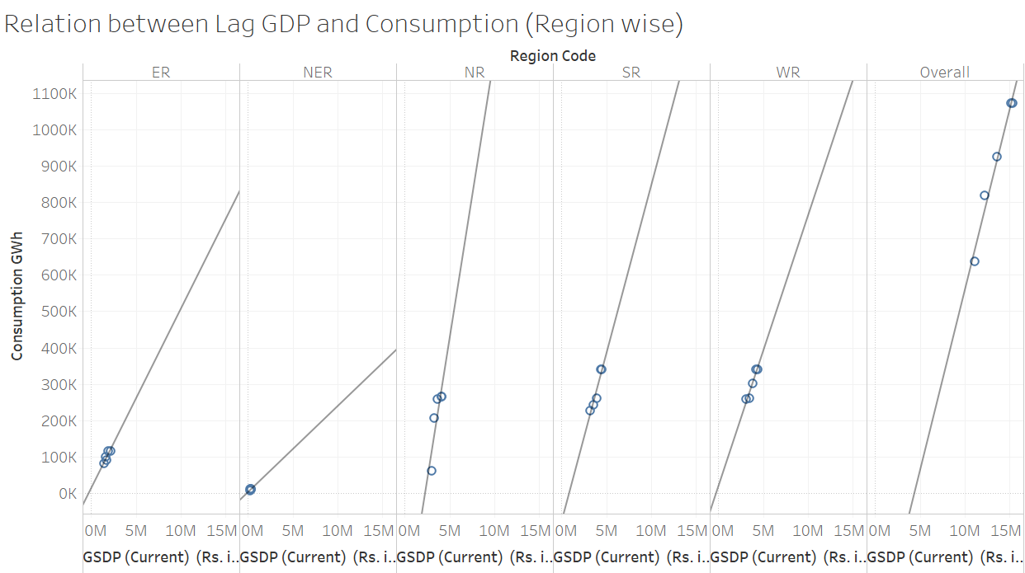
Relation between Lag GDP and Energy Consumption (By Region)- Linear Regression
The model coefficient (slope of regression line) is high for Northern region followed by Southern and Western Regions.
Higher the model coefficient the change in Lag GDP result to higher change in Consumption in the same direction.

Slide 10
Norther Region
GDP Contribution for Norther region:
The Norther region is having sates like Delhi, Haryana ,Rajasthan , Chandigarh which are major Industrial states
Himachal Pradesh, Punjab are having the most fertile regions in India prospered as a consequence of the Green Revolution.
Energy Consumption for Northern Region
Most of the states are Industrialised, as the production to increase the consumption of energy also increases over period of time.
Agriculture is more or less dependent on the availability of electricity, which also contributes it figure in consumption of electricity.
Over a period of 2014-2017 , the growth of in Northern region is evidently following linear relation ship between the GDP and the energy consumption than compared to other regions.

Slide 11
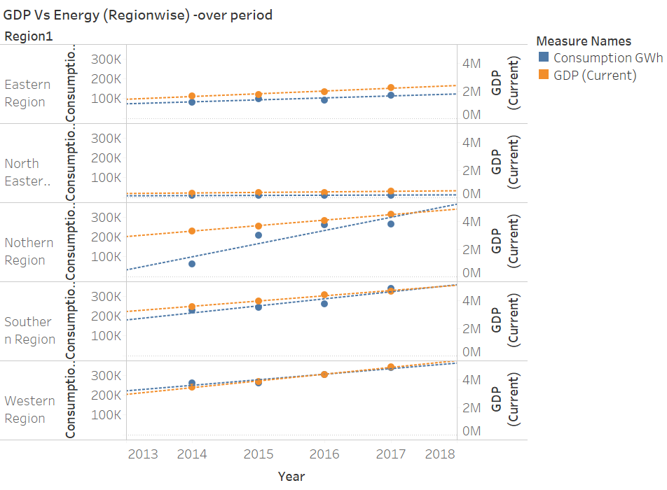
Relationship between GDP and Energy over 4 years(2014-17)
The GDP growth rate from 2014 to 2017 is not similar across the regions but still follows an increasing trend.
Except the Norther region , all the regions having inline growth of GDP with the energy consumption.
The Norther region , has sharp increase of GDP and as well as Energy consumption, which evolves to have
stronger relationship with each other over period of 2014-2017.
The Western region and the North Eastern region has more positive correlation between Energy consumption
and GDP

Slide 12
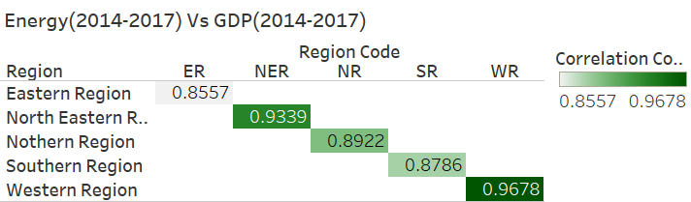
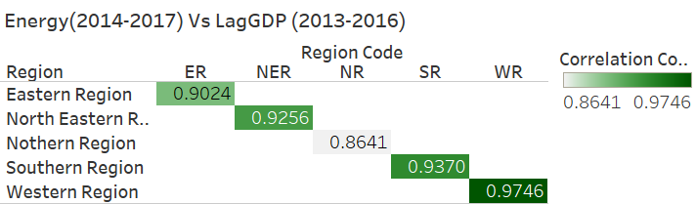
GDP and Energy Consumption (Region) - Correlation
All regions have very good positive correlation between GDP/Lag GDP and energy consumption.
Western region has high positive correlation coefficient between GDP / Lag GDP and Energy Consumptions across the country, which shows that western region is having exceptionally well for all the years.
The western region generates 24% of the national GDP of the country, with an annual growth rate of 14.5% as of 2017. The states generate about 23% of the tax revenues of the country. More than 85% of the households have access to electricity. Agriculture employs most people in this region, while services have largest share in the total GDP

Slide 13
Western Region
The western region includes more of industrialisation , urban areas as a factor that contribute to GDP and energy consumption.
States like Goa ,Gujrat, Maharashtra which are more developed states and have major portion in the national GDP.
Demonetisation and Introduction of GST could have been a cause of decrease in linear relation ship between the GDP and Energy consumption.

Slide 14
Relation between Lag GDP and Energy Consumption (By Region) - Linear Regression Model Coefficients
Region | East | North-East | North | South | West | Overall
Consumption Vs Lag GDP (Correlation coefficient) | 90.2% | 92.6% | 86.4% | 93.7% | 97.5% | 98.8%
Slope(Lag GDP) | 0.0493 | 0.0236 | 0.1557 | 0.09249 | 0.0745 | 0.0993
Intercept(Lag GDP) | 12178 | 2135 | 357031 | -80598 | 17718 | -436454
P-Value( GDP) | 4% | 18% | 3% | 1% | 1% | 0%
Norther region shows strong relationship between GDP and Energy consumption which is evident by high GDP coefficient compared to other regions.
The Western region with high correlation coefficient is doing exceptionally well compared to other regions followed by south region.
However, the Consumption trend is similar to GDP from 2014 to 2017 and is evident by high correlation (>85%) between Consumption and GDP for all Regions.

Slide 15
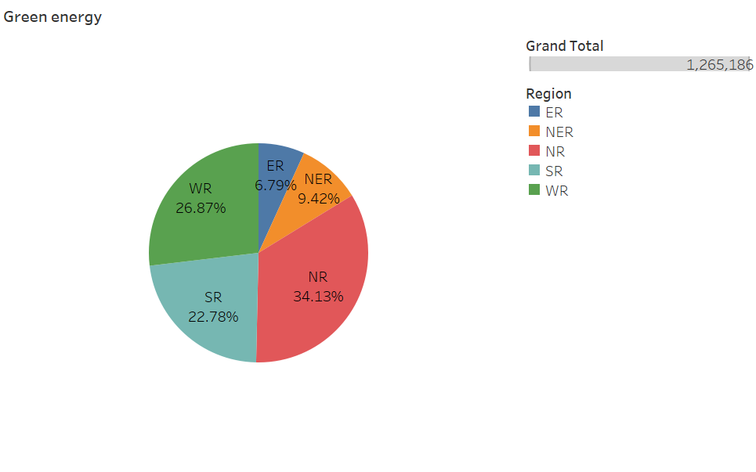
Relationship between GDP and Energy (Green energy technology)
Region | East | North-East | North | South | West | Overall
Slope(GDP) | 0.0493 | 0.0236 | 0.1557 | 0.09249 | 0.0745 | 0.0993
Intercept | 12178 | 2135 | 357031 | -80598 | 17718 | -436454
P-Value | 4% | 18% | 3% | 1% | 1% | 0%
The Norther region,
Generates 34% of total Renewable energy in the country.
Per unit Increase in GDP, results to higher growth in Consumption compare to other regions.
The increase in GDP results to expected increase Consumption of 15.57% for North region and for other regions it is from 2% to 10%.
From this it is evident that Green energy technology is having positive impact on GDP and Energy consumption

Slide 16
Thank you

